Slide 1
EFB 312
International Finance

Slide 2
Some Basics
What’s Special about “International” Finance?
Goals for International Financial Management
Globalization of the World Economy
Multinational Corporations
1-2

Slide 3
What’s Special about “International” Finance?
Foreign Exchange Risk and Political Risks
Market Imperfections
Expanded Opportunity Set

Slide 4


What’s Special about “International” Finance:
Foreign Exchange Risk
Foreign Exchange Risk
  This is risk that foreign currency profits may evaporate in local currency terms due to unanticipated unfavorable exchange rate movements.
  Suppose $1 = ¥100 and you buy 10 shares of Toyota at ¥10,000 per share. (cost ¥100,000, or US$ 1,000)
  When you sell the shares, the investment is worth ten percent more in yen: ¥110,000.
  But, if the yen has depreciated to $1 = ¥120, your investment has actually lost money in U.S. dollar terms:
USD cost of shares
USD value of shares at sale:
$$\$1,000=¥100,000×\frac{\$1}{¥100}$$
$$\$916.67=¥110,000×\frac{\$1}{¥120}$$
Notes:
At year-end, your $1,000 investment is only worth $916.67 = ¥110,000 × $1/¥120

Slide 5
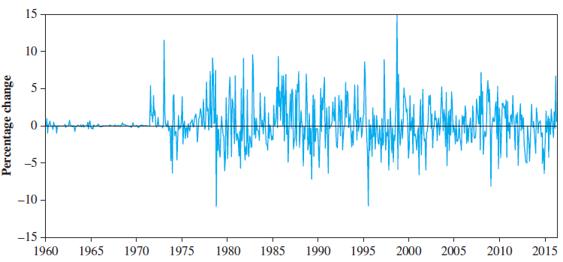
Example: Monthly Percentage Change in Japanese Yen—U.S. Dollar Exchange Rate

Slide 6
What’s Special about “International” Finance: Political Risk
Political Risk
  Sovereign governments have the right to regulate the movement of goods, capital, and people across their borders.
  These laws sometimes change in unexpected ways.

Slide 7
What’s Special about “International” Finance: Market Imperfections
Market Imperfections
  Legal restrictions on the movement of goods, people, and money
  Transactions costs
  Shipping costs
  Tax arbitrage

Slide 8
Example: Nestlé’s Market Imperfection
Nestlé used to issue two different classes of common stock bearer shares and registered shares.
  Foreigners were only allowed to buy bearer shares.
  Swiss citizens could buy registered shares.
  The bearer stock was more expensive.
On November 18, 1988, Nestlé lifted restrictions imposed on foreigners, allowing them to hold registered shares as well as bearer shares.
1-8

Slide 9
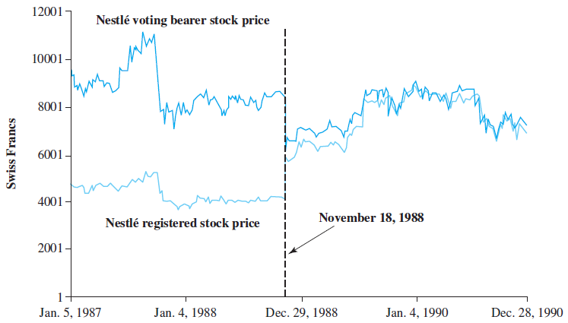
Daily Prices of Nestlé’s Bearer and Registered Shares

Slide 10
Nestlé’s Market Imperfection Concluded
Following this, the price spread between the two types of shares narrowed dramatically.
  This implies that there was a major transfer of wealth from foreign shareholders to Swiss shareholders.
Foreigners holding Nestlé bearer shares were exposed to political risk in a country that is widely viewed as a haven from such risk.
Nestlé episode illustrates both the importance of considering market imperfections and the peril of political risk.
Notes:
The Bearer and Registered shares of Nestlé had the same claims on dividends but differential voting rights. Chapter 17 provides a detailed discussion of the Nestlé case.

Slide 11
What’s Special about “International” Finance: Expanded Opportunity Set
Expanded Opportunity Set
  It doesn’t make sense to play in only one corner of the sandbox.
  Firms can gain from greater economies of scale when their tangible and intangible assets are deployed on a global basis.
  True for corporations as well as individual investors.

Slide 12
Goals for International Financial Management
The focus of this course is to equip you with the “intellectual toolbox” of an effective global manager
What goal should this effective global manager be working toward? What is your social responsibility?
    Maximization of shareholder wealth?
or
    Other goals?

Slide 13
Maximization of Shareholder Wealth
Long accepted as a goal in developed countries, but complications arise.
  Who are and where are the shareholders?
  In what currency should we maximize their wealth?

Slide 14
Other Goals: Stakeholders
In other countries shareholders are viewed as merely one among many “stakeholders” of the firm including:
  Employees
  Suppliers
  Customers
In Japan, managers have typically sought to maximize the value of the keiretsu—a family of firms to which the individual firms belongs.

Slide 15
Other Goals: Principal Agent Conflict
As shown by a series of recent corporate scandals at companies like Enron, WorldCom, and Global Crossing, managers may pursue their own private interests at the expense of shareholders when they are not closely monitored.
These calamities have painfully reinforced the importance of corporate governance, i.e., the financial and legal framework for regulating the relationship between a firm’s management and its shareholders.

Slide 16
Other Goals: Business Culture
These types of issues can be much more serious in many other parts of the world, especially emerging and transitional economies, such as Indonesia, Korea, and Russia, where legal protection of shareholders is weak or virtually non-existing.
No matter what the other goals, they cannot be achieved in the long term if the maximization of shareholder wealth is not given due consideration.

Slide 17
Globalization of the World Economy: Major Trends and Developments
Emergence of Globalized Financial Markets
Emergence of the Euro as a Global Currency
Europe’s Sovereign Debt Crisis of 2010
Trade Liberalization and Economic Integration
Privatization
Global Financial Crisis of 2008-2009

Slide 18
Emergence of Globalized Financial Markets
Deregulation of Financial Markets coupled with
Advances in Technology
  have greatly reduced information and transaction costs, which has led to:
Financial Innovations, such as
  Currency futures and options
  Multi-currency bonds
  Cross-border stock listings
  International mutual funds
  Exchange-Traded Funds (ETFs)

Slide 19
Emergence of the Euro as a Global Currency
A momentous event in the history of world financial systems.
Currently more than 300 million Europeans in 19 countries are using the common currency on a daily basis.
  Austria, Belgium, Cyprus, Estonia, Finland, France, Germany, Greece, Ireland, Italy, Latvia, Lithuania, Luxembourg, Malta, the Netherlands, Portugal, Slovenia, Slovakia and Spain.
The “transaction domain” of the euro may become larger than the U.S. dollar’s in the near future.

Slide 20
Europe’s Sovereign-Debt Crisis of 2010
In December of 2009, Greek government revealed that its budget deficit for the year would be 12.7% of GDP, not the 3.7% forecast.
Investors sold off Greek government bonds and the ratings agencies downgraded them to “junk.”
While Greece represents only 2.5% of euro-zone GDP, the crisis became a Europe-wide debt crisis.
The challenge remains that fiscal indiscipline of one euro-zone country can escalate to a Europe-wide crisis.

Slide 21
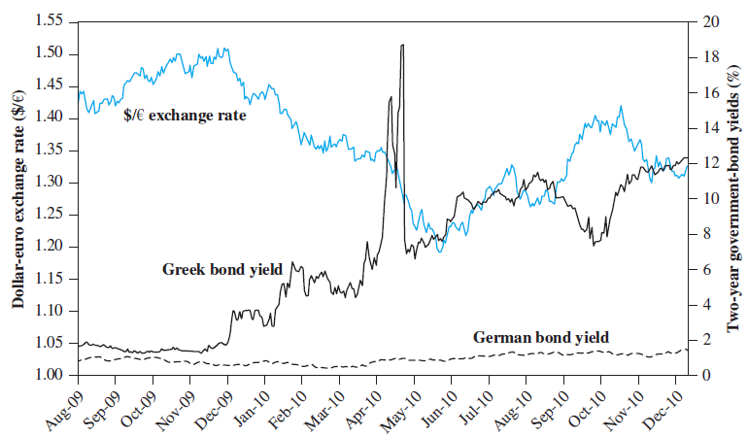
Greek Drama
Greece paid no premium above the German rate until late fall 2009.
Greek interest rate rose until the bailout package on May 9.

Slide 22
Trade Liberalization and Economic Integration
Over the past 50 years, international trade increased about twice as fast as world GDP.
There has been a change in the attitudes of many of the world’s governments, who have abandoned mercantilist views and embraced free trade as the surest route to prosperity for their citizenry.
The principal argument for international trade is based on the theory of comparative advantage.
Notes:
See the appendix to this chapter for a more complete discussion of the theory of comparative advantage.

Slide 23
Liberalization of Protectionist Legislation
General Agreement on Tariffs and Trade (GATT) is a multilateral agreement among member countries that has reduced many barriers to trade.
World Trade Organization has the power to enforce the rules of international trade.
On January 1, 2005, the era of quotas on imported textiles ended.
This is an event of historic proportions.

Slide 24
NAFTA
North American Free Trade Agreement (NAFTA) called for phasing out impediments to trade between Canada, Mexico, and the United States over a 15-year period beginning in 1994.
  Full implementation occurred in 2009.
For Mexico, the ratio of export to GDP has increased dramatically from 2.2% in 1973 to 31.7% in 2011.
The increased trade has resulted in increased numbers of jobs and a higher standard of living for all member nations.

Slide 25
Brexit
The unexpected outcome of a British referendum held on June 23, 2016.
Britons voted to leave the EU.
Likely outcome is a weakening of both the United Kingdom and the European Union.
Brexit revealed some of the difficulties with free trade and global economic integration.
  The free movement of goods, capital and people leads to economic growth, but also leads to political opposition.

Slide 26
Global Financial Crisis of 2008—2009
The “Great Recession” was the most serious, synchronized economic downturn since the Great Depression of the 1930s.
Factors included:
  Households and financial institutions borrowed too much and took too much risk.
  This risk was repackaged with securitization
  Defaults on subprime mortgages in the U.S. came to threaten the solvency of a teacher’s retirement plans in Norway.

Slide 27
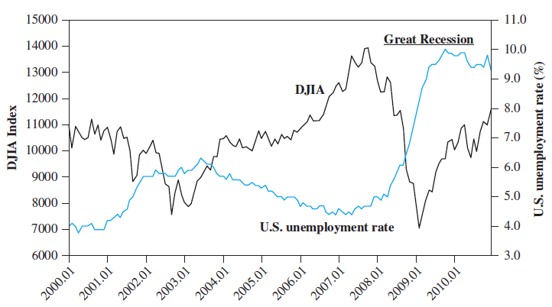
U.S. Unemployment Rate and Dow Jones Industrial Average
During the course of the crisis, G-20 emerged as the premier forum for discussing international economic issues and coordinating financial regulations and macroeconomic policies

Slide 28
Multinational Corporations
A multinational corporation (MNC) is a firm that has been incorporated in one country and has production and sales operations in other countries.
There are about 60,000 MNCs in the world.
Many MNCs obtain raw materials from one nation, financial capital from another, produce goods with labor and capital equipment in a third country, and sell their output in various other national markets.

Slide 29
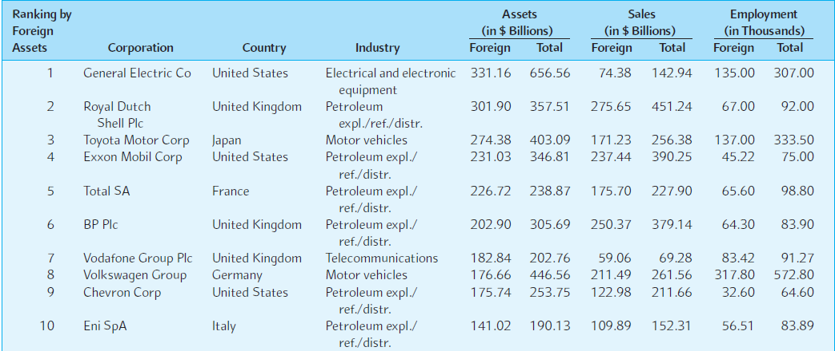
Top Nonfinancial MNCs

Slide 30
Australian MNCs
 | Foreign Sales | Foreign Assets
BHP | 56% | 24%
Rio Tinto | 93% | 48%
Westfield | 50% | 57%
Telstra | 6% | 11%
Woodside | 90% | 29%
Woolworths | 0% | 0%
Fosters | 37% | 48%
Brambles | 83% | 86%
AVERAGE | 46% | 34%

